Slide 1
Project Presentation of CO-OP Project at Industry (Module-2) (22CS421)
On
IntraManage-Next-Gen Industry Project Platform
Supervised By
Dr. Gifty Gupta
Adarsh Kumar Pathak (2210991178)
Aditi (2210991180)
Aargya Sharma (2210991116)
Kapil (2210991744)
Department of Computer Science and Engineering, Chitkara University, Punjab

Slide 2
Introduction
IntraManage is an industry project management platform designed to improve coordination and efficiency in academic and industry-based environments. Traditional project handling relies on informal communication and disconnected tools, leading to poor collaboration, difficulty in tracking progress, and reduced accountability. This system provides a centralized and structured solution to manage roles, monitor project stages, and ensure secure collaboration among all stakeholders.

Slide 3
Problem
The Problem: Project management in academic and industry environments is often handled using informal tools like spreadsheets and scattered communication channels, leading to inefficiency.
The Impact: This results in poor coordination, lack of transparency, difficulty in tracking progress, and reduced accountability among administrators, managers, and interns.
The Challenge: Without a centralized system and real-time visibility, managing tasks, monitoring performance, and ensuring structured collaboration becomes complex and time-consuming.

Slide 4
Abstract & Objective
Abstract: A role-based Industry Project Management System designed to enable secure collaboration, efficient task management, and real-time progress tracking using a centralized platform. It integrates project monitoring, role-based access, and performance tracking to ensure a structured and organized workflow.
Objective: To develop a structured and scalable system that improves coordination, transparency, and workflow management among Admin, Manager, and Intern users. To simplify project handling by providing real-time updates, secure access control, and efficient communication.

Slide 5
Methodology
System Design: Designed a role-based architecture with three user levels — Admin, Manager, and Intern — ensuring secure and structured access control.
Development Approach: Built a full-stack web application using the MERN stack, integrating frontend, backend, and database for seamless functionality.
Core Functionalities Implementation: Developed modules for authentication, project management, task assignment, progress tracking, and file handling.
Monitoring & Tracking: Implemented real-time activity tracking and performance monitoring to ensure transparency and accountability across all users.

Slide 6
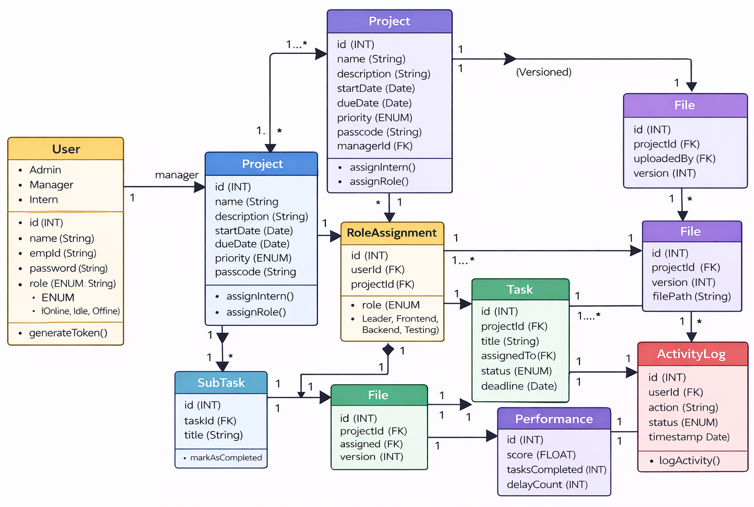
UML Diagram

Slide 7
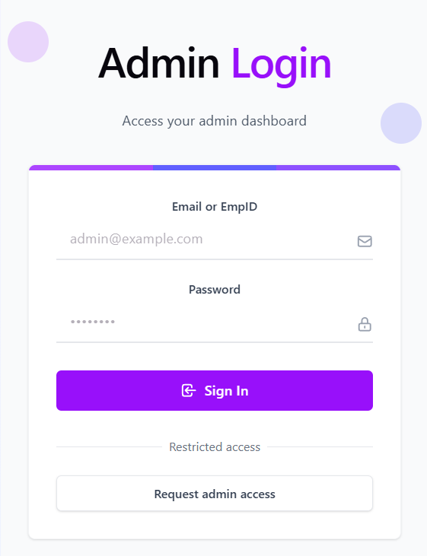
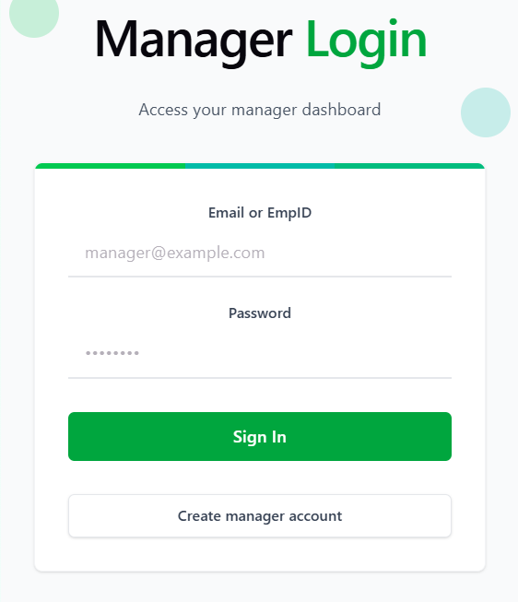
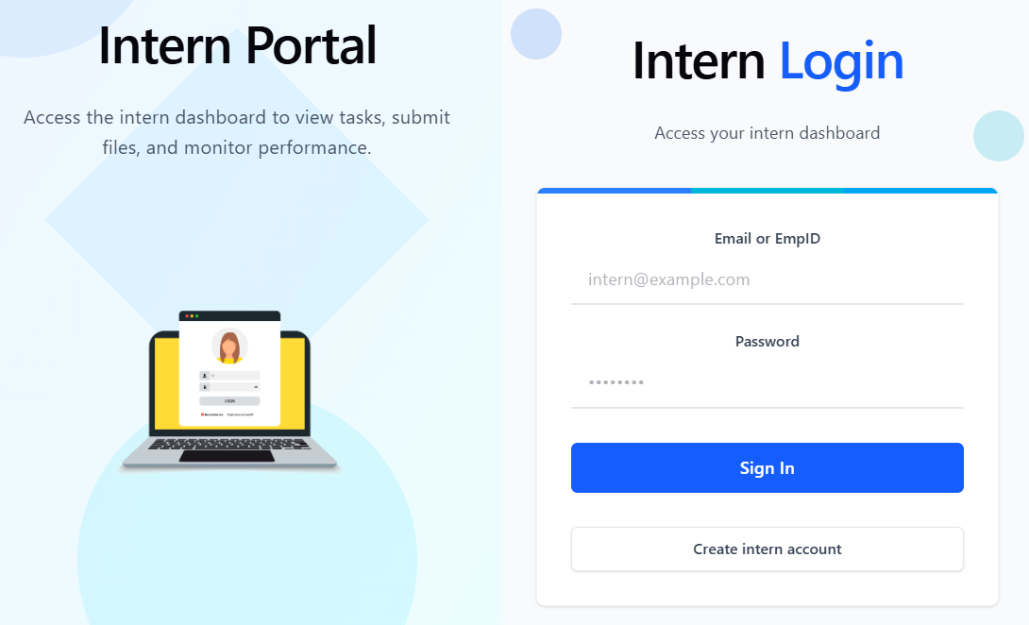
Screenshots

Slide 8
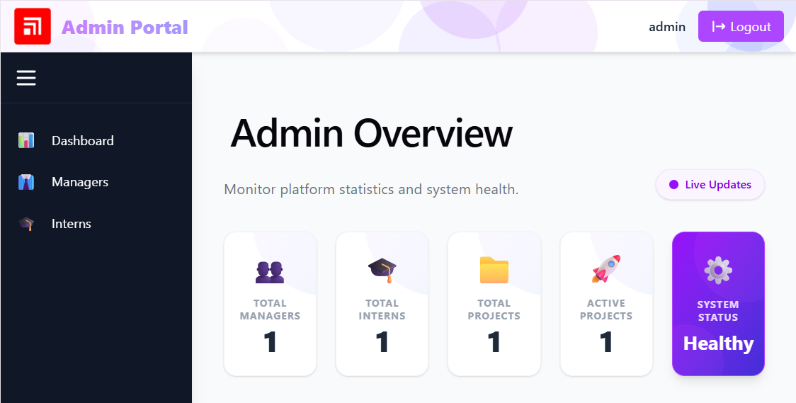
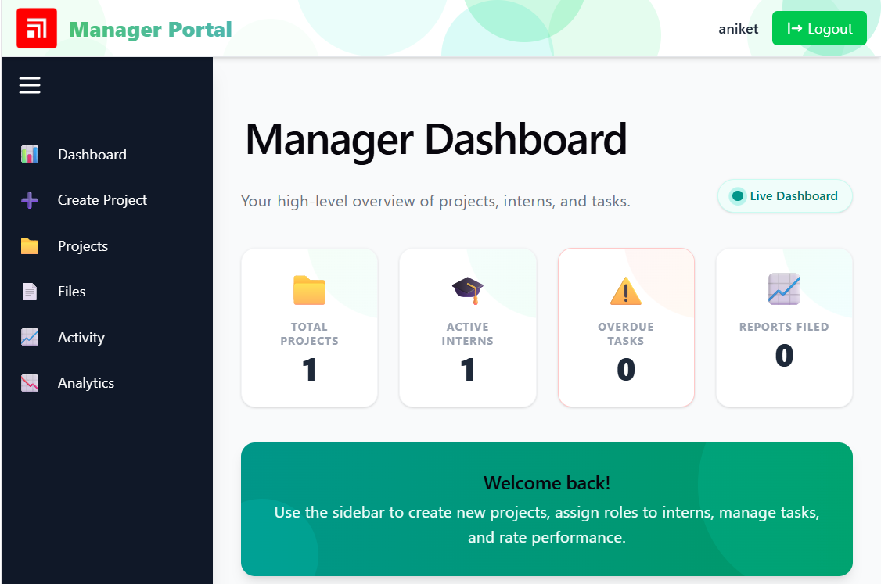
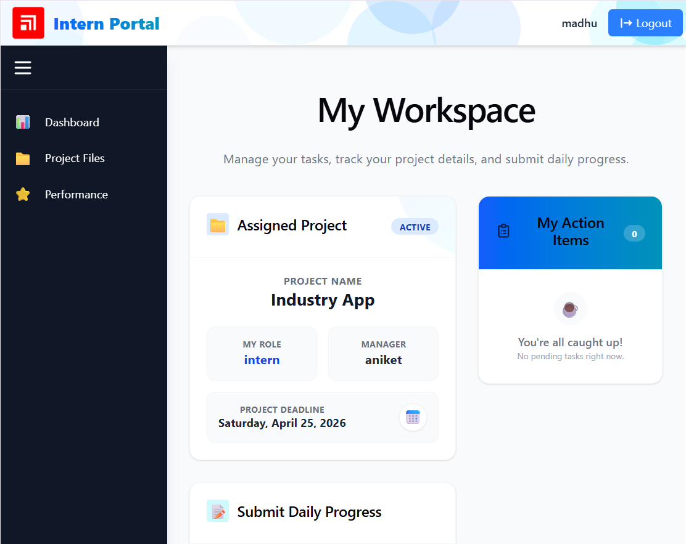
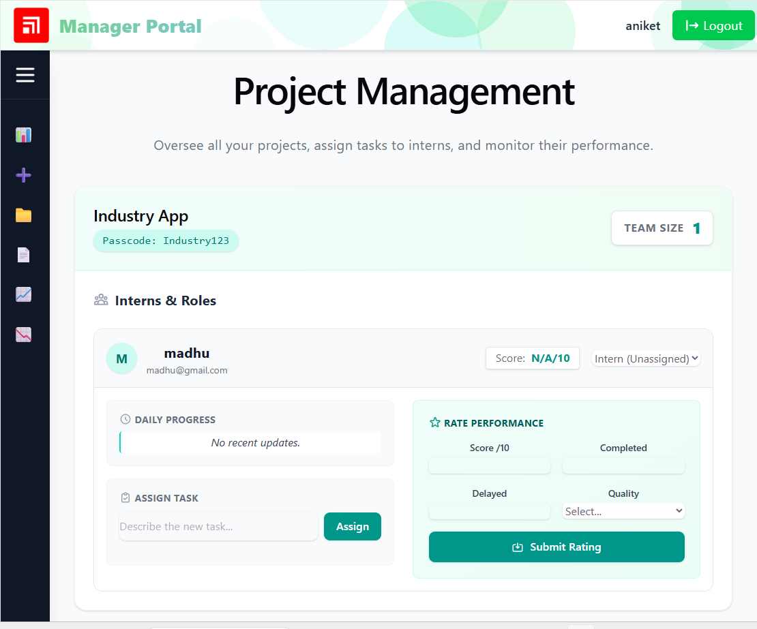

Slide 9
Why MERN Stack?
Full-Stack JavaScript: Uses a single language (JavaScript) across frontend and backend, making development faster and more consistent.
Scalability & Flexibility: Easily handles growing data and users, making it suitable for real-world project management systems.
Efficient Development: React enables reusable components, while Node.js and Express provide fast and lightweight backend services.
Seamless Integration: MongoDB integrates smoothly with the application, allowing efficient storage and retrieval of project data.

Slide 10
Advantages & Results
Improved Coordination: The system enables smooth collaboration between Admin, Manager, and Interns through a centralized platform.
High Transparency & Accountability: Real-time activity tracking and role-based access ensure clear visibility of tasks and responsibilities.
Efficient Performance Monitoring: Managers can easily track progress, evaluate performance, and identify delays in project execution.
Time & Resource Efficiency: Automates task management, reduces manual effort, and speeds up overall project workflow.

Slide 11
Future Scope
Real-Time Collaboration: Integration of WebSockets to enable instant updates and seamless real-time communication between users.
AI-Based Analytics: Incorporating AI for performance evaluation, project delay prediction, and intelligent insights.
Cloud Integration: Migrating file storage to cloud platforms like AWS S3 or Firebase for better scalability and security.
Enhanced Communication: Adding email and push notification systems for timely updates and alerts.
Mobile Application: Developing a mobile app version for better accessibility and on-the-go project management.

Slide 12
Conclusion
Summary: The proposed Industry Project Management System provides a structured, role-based platform that integrates project management, task tracking, and real-time monitoring within a single application.
Final Impact: It enhances coordination, transparency, and accountability among users while simplifying workflow management and improving overall productivity in academic and industry-based projects.

Slide 13
Thank You

